Slide 1
Map, Food, & Smiles
Hsuan-Ting Ho, 何泫霆 (Scottie)
20240419 TEN MFS.key

Slide 2
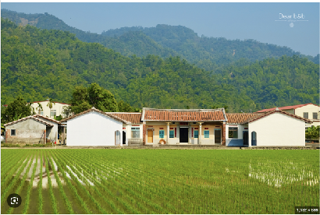
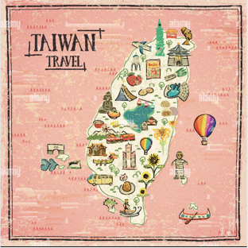


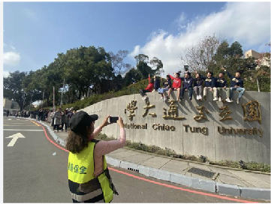
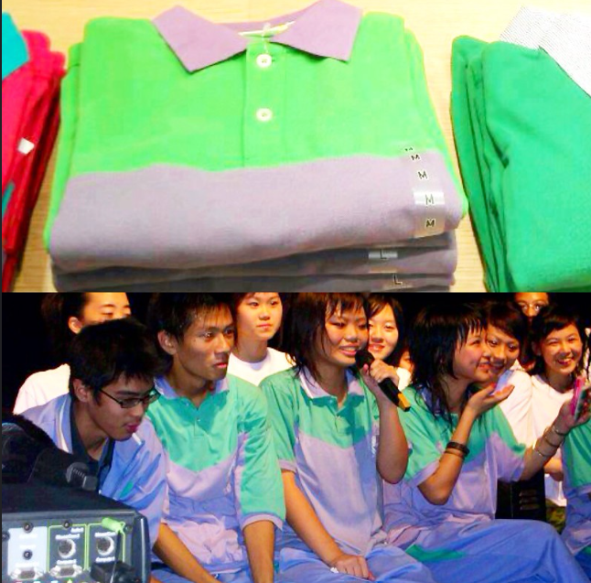
Maps
1996: Kaohsiung, TW
2021 NTHU
2015: HPSH
2021-present: NYCU
Title

Slide 3
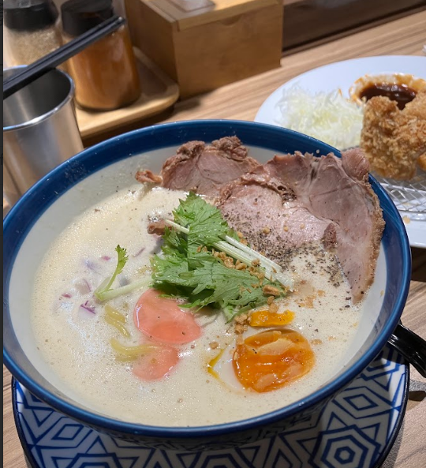
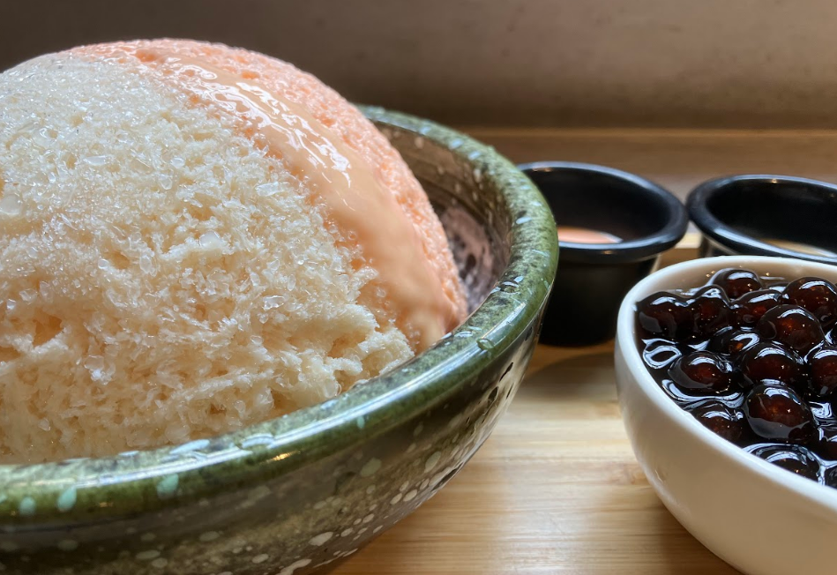
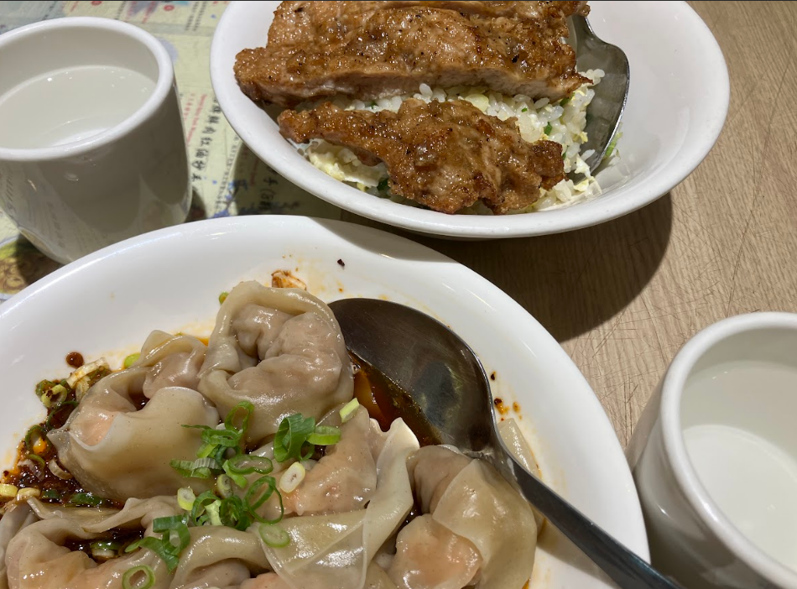
Food
Ramen Shaved ice
Traditional Chinese meals
Title

Slide 4

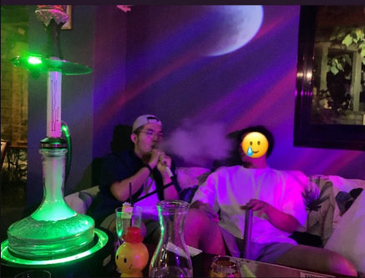



Smiles
Dating App (2019~ ??)
Hookah (2023~now)
Reading (2022~now )
Title

Slide 5
Map, Food, Smiles
T2
20240419 TEN MFS.key

